Slide 1
TRAIN RESERVATION
Documentation by:
Lahari

Slide 2
Contents
Introduction
Modules
Diagrams
Instructions to execute .

Slide 3
Introduction
The Application allows Validated users to
-View list of trains.
-Choose a particular train.
-Book tickets, maximum of 4 tickets at once.
-View Ticket.

Slide 4
Modules
Registration module
-enter username , password
-store in database
Login Module
-Validate user details
-Display Train Details

Slide 5
Modules
Booking Module
-Choose a Train
-Give Passenger details
-Book Ticket
-View Ticket
Check Order History

Slide 6
Diagrams
Use case Diagram
Class Diagram
Sequence Diagram

Slide 7
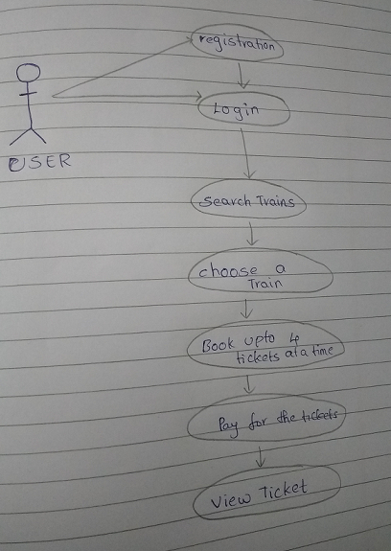
Use case Diagram

Slide 8
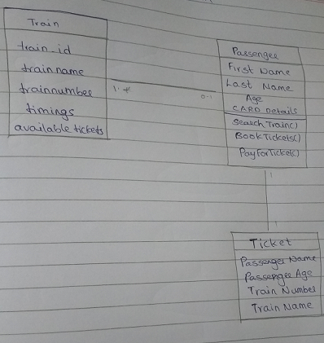
Class Diagram

Slide 9
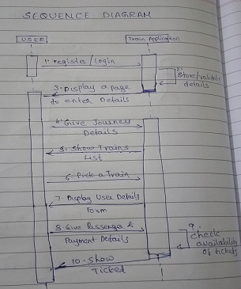
Sequence Diagram

Slide 10
Instructions to run
The start of the program:
-localhost:8080/login
Software needed:
-STS
-Java1.8
-Tomcat8

